Slide 1
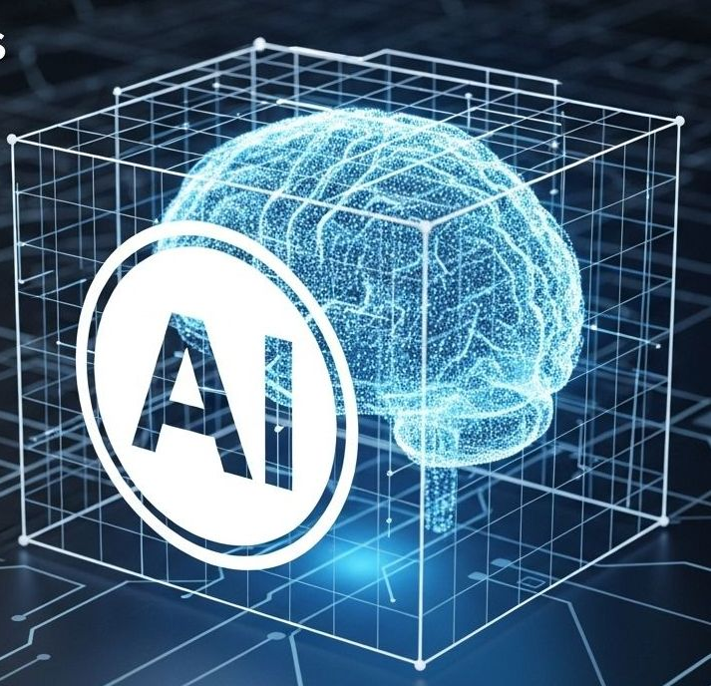

ALY 3510 AI Foundations:
An Interdisciplinary Approach
Lecture 4:
Neural Networks & Deep Learning
Session/Section: Fall 2026
Time: Monday 5:50-7:10 PM and Virtual
Instructor: Vladimir Shapiro

Slide 2
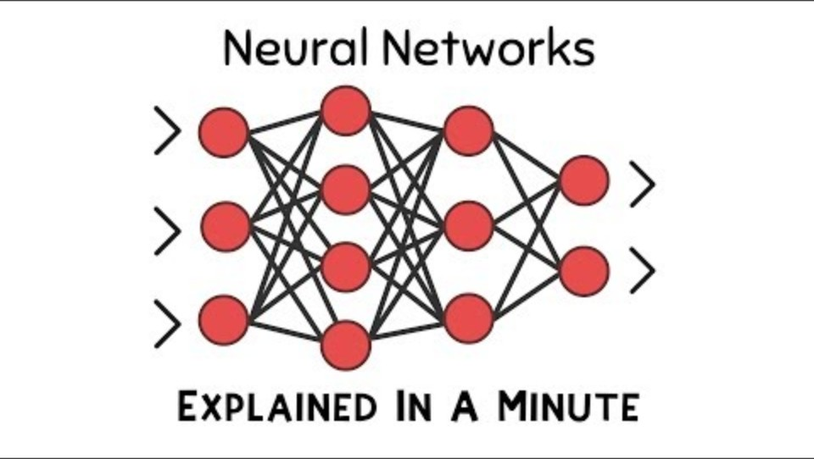
Pre-Lecture Video (1:03)
https://www.youtube.com/watch?v=rEDzUT3ymw4

Slide 3
Agenda
Pre-lecture video
Lecture
In-class discussion
Note: No classroom session next Monday due to the federal holiday in the U.S. A recording will be posted instead.
Team formation for Final project is due next week.
Notes:
.

Slide 4
Part 1: Introduction to Neural Networks
From biological neurons to Multilayer Perceptrons

Slide 5
Quick Recap: What is Machine Learning?
Core insight from last weeks: instead of writing rules, we let computers discover them from data.
Traditional (Symbolic AI)
Machine Learning
Write thousands of rules by hand
“IF contains ‘free money’ → spam”
Spammers adapt → start over
Show examples of real spam
The algorithm finds the patterns
The model adapts automatically

Slide 6
Why Neural Networks? End-to-End Learning
Traditional approach
Raw data → manual feature extraction → learning algorithm → output (a human decides which features matter)
Neural network approach (end-to-end)
Raw data → neural network → output (the network discovers which features matter, automatically)
Key advantage: eliminates manual feature engineering.

Slide 7
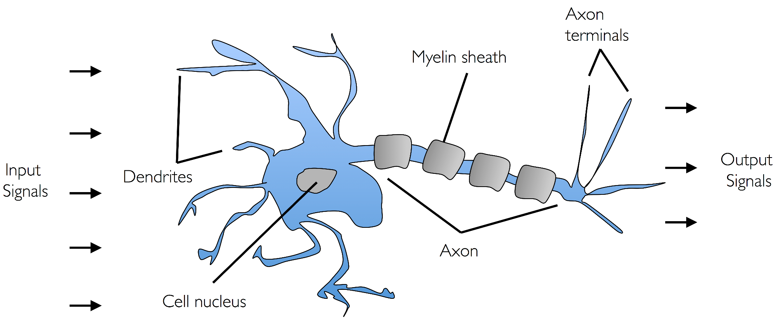
Inspiration from the Brain
The neuron is the brain’s basic computational unit.
Dendrites receive signals from other neurons
The cell body integrates (adds up) incoming signals
If the signal exceeds a threshold, the axon fires an output
~86 billion neurons in the human brain
https://www.cs.toronto.edu/~urtasun/courses/CSC411_Fall16/10_nn1.pdf

Slide 8
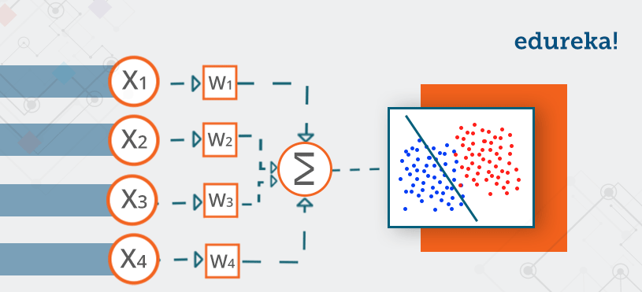
The Artificial Neuron (Perceptron)
Rosenblatt, 1958
A decision-maker weighs multiple factors, combines the evidence, and then fires a yes/no based on a threshold.
Biological → artificial:
  dendrites = inputs
  synaptic strength = weights
  cell body = summation
  axon = output.

Slide 9
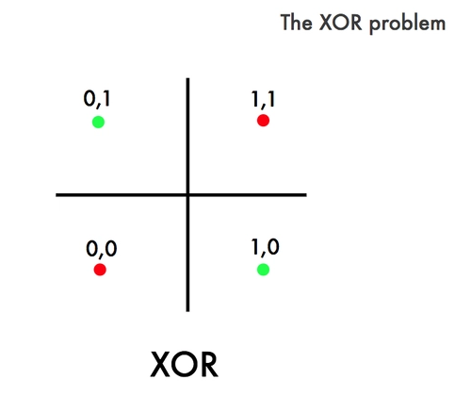
The Perceptron's Fatal Flaw
Problem: a single perceptron can’t learn patterns that aren’t linearly separable
No single straight line can separate the green points from the red points.
Solution: stack multiple layers of neurons → the Multi-Layer Perceptron.

Slide 10
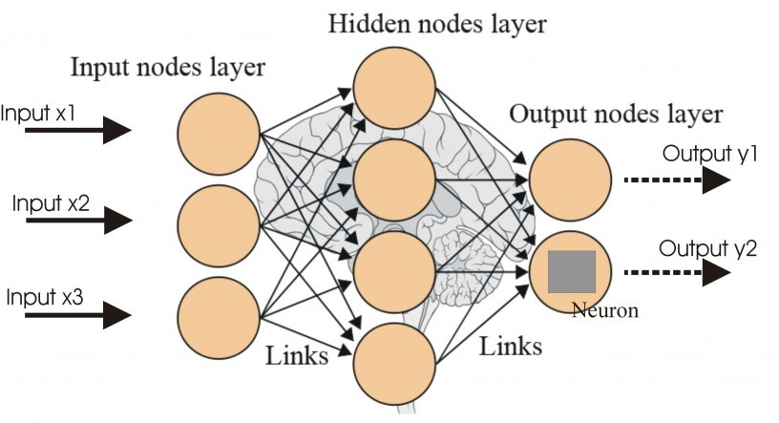
Multi-Layer Perceptron (MLP)
Connect many neurons in layers to solve complex problems.
Like a team solving a complex problem — each member contributes specialized analysis.

Slide 11
Neural Network Terminology
Term | What it means
Width | Number of neurons per layer
Depth | Number of layers in the network
Parameters | All weights and biases — the learnable values
Bias | An extra adjustable value added at each neuron
More parameters = more capacity to learn complex patterns—but also more data required.

Slide 12
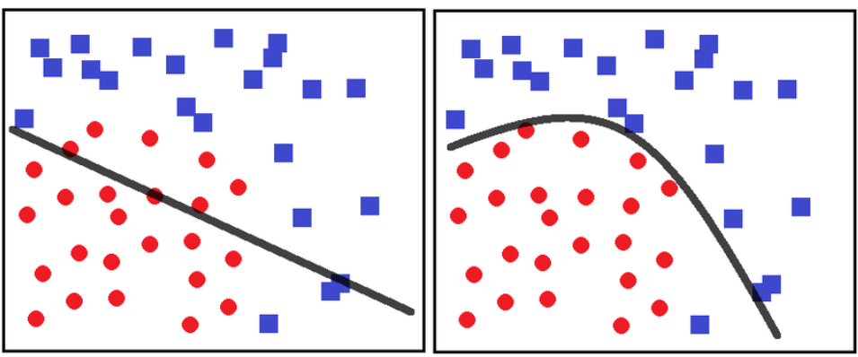
The Power of Neural Networks
Multilayer networks learn complex, non-linear decision boundaries — curves, not just straight lines
Universal Approximation Theorem
Given enough neurons, a neural network can learn ANY pattern in your data.
Caveat: just because a solution EXISTS doesn’t mean it’s easy to FIND. Training is the hard part.
https://share.google/images/F2MofAUu4Gg579cat

Slide 13
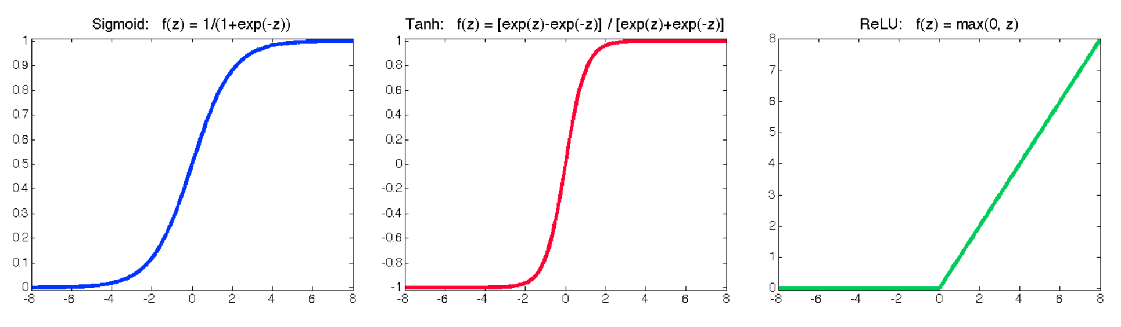
Activation Functions: Adding Nonlinearity
Without activation functions, stacked layers would collapse into a single linear transformation.
Function | What it does | Good for
Sigmoid | Squashes values to 0–1 | Probabilities
ReLU | Zero for negatives, linear above | Hidden layers (fast)
Softmax | Turns scores into probabilities that sum to 1 | Multi-class output

Slide 14
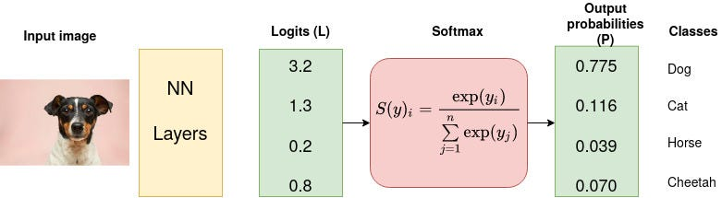
Softmax: From Scores to Probabilities
Converting raw network outputs into interpretable probabilities
Softmax example — image classification:
Class | Raw score | Probability
Dog | 3.2 | 77.5% ✓
Cat | 1.3 | 11.6%
Horse | 0.2 | 3.9%
Cheetah | 0.8 | 7.0%
All probabilities sum to 100% — the network is “most confident” it’s a dog.

Slide 15
Part 2: How Neural Network Learn
How does a network with millions of connections learn from its mistakes?

Slide 16
How Training Works: The Cycle
1. Forward Pass
Input → Prediction
4. Update Weights
REPEAT
until accurate
2. Calculate Loss
Adjust & improve
How wrong?
3. Backward Pass
Find the blame
Goal: Minimize the loss function (reduce prediction errors)

Slide 17
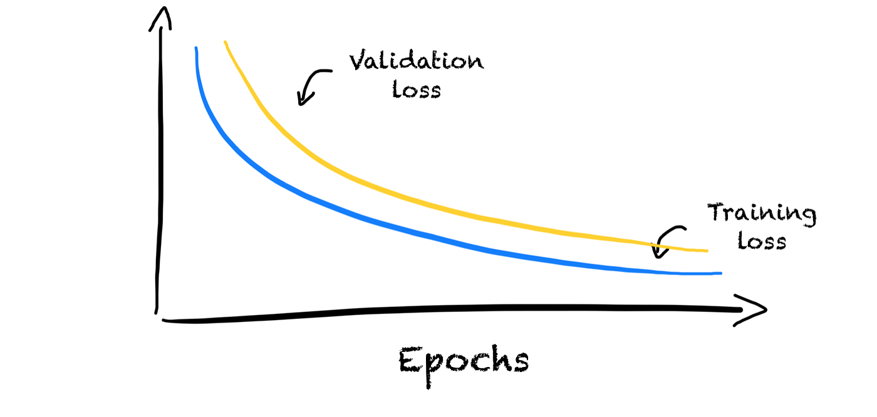
Learning in Action: A Concrete Example
Task: Classify images as Dog or Cat
1. Input
Dog image (pixels)
2. Forward
Network predicts: "Cat"
3. Loss
High! (wrong answer)
4. Backward
Calculate weight adjustments
5. Update
Adjust weights to favor "Dog"
After thousands of examples, the network learns features that distinguish dogs from cats!

Slide 18
Measuring Error: Loss Functions
Loss = how wrong the model’s predictions are.
Prediction vs. reality comparison = loss
The choice of loss function shapes what the network optimizes for.
Common types: Mean Squared Error (regression) · Cross-Entropy (classification).

Slide 19
Backpropagation: Assigning Blame
With millions of weights, how do we know which ones to adjust?
The idea
When wrong, work backwards through the network to find which connections contributed most to the error — then adjust them proportionally. (1) start at the output error → (2) work backward layer by layer → (3) adjust each weight by its share of the blame.
Like tracing a mistake in a group project back through each member’s contribution — to see who was responsible for what.

Slide 20
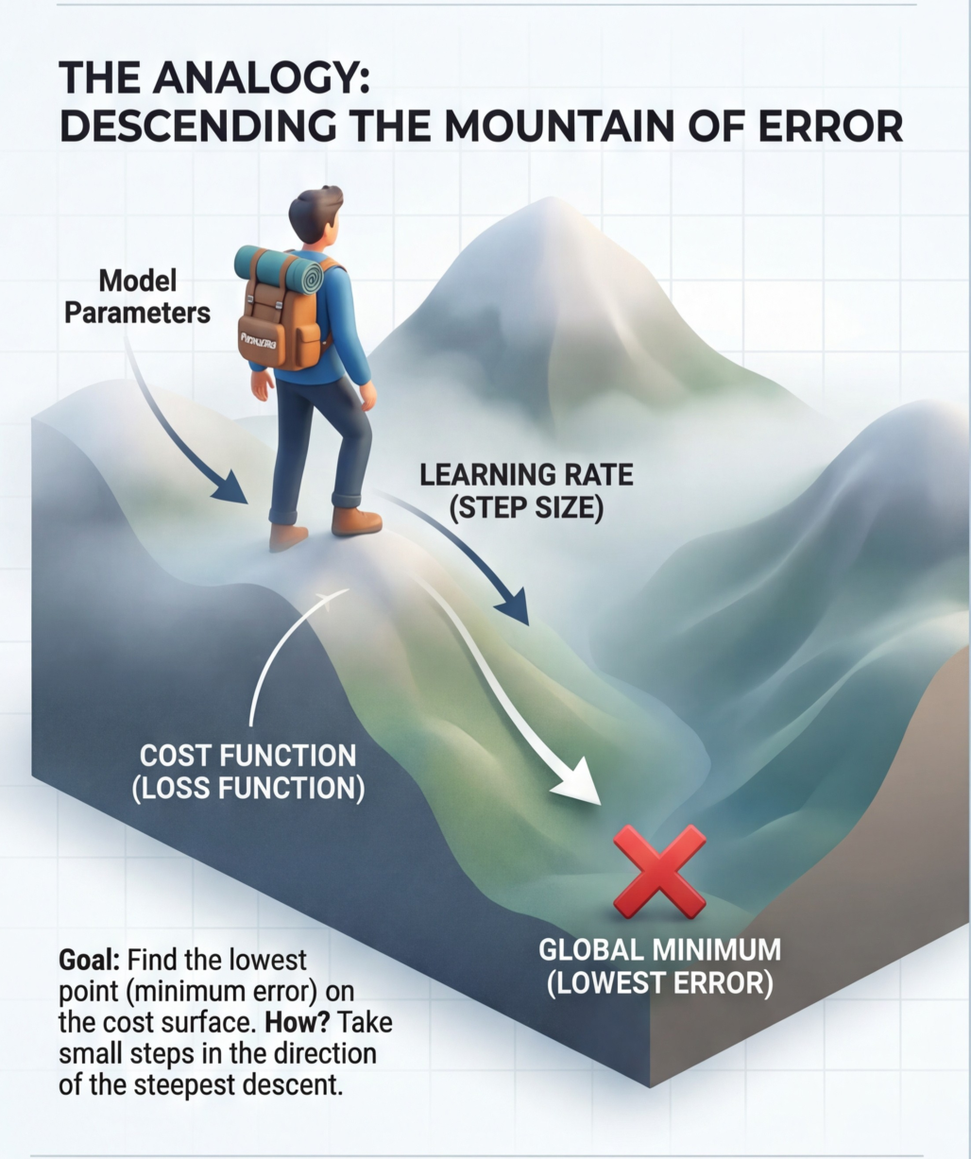
Finding the Best Weights: Gradient Descent
Analogy — the hiker: to find the lowest point in a hilly landscape, feel which direction is steepest downhill and take a step. Repeat.
Learning rate = step size
Too large: overshoot the minimum — bounce around, never settle.
Too small: training takes forever — tiny steps, slow progress.
https://share.google/images/YLkebnXi1L8QzufqQ

Slide 21
Monitoring Training Progress
Healthy training: loss decreases, accuracy increases over time. Watch for these warning signs:
Pattern | Problem | Fix
Train loss ↓, validation loss ↑ | Overfitting | Early stopping, regularization
Both losses plateau high | Underfitting | Bigger network, more features
Loss oscillates wildly | Learning rate too high | Reduce the learning rate
Always monitor both training AND validation metrics.

Slide 22
Part 3: Hyperparameters
The "knobs" you can turn to improve training

Slide 23
Key Hyperparameters
A hyperparameter is a configuration variable set before a machine learning model begins training that controls how the model learns. A hyperparameter is set, not learned.
Hyperparameter | What it controls | Typical range
Learning rate | Step size for weight updates | 0.001 – 0.1
Batch size | Examples processed before an update | 32 – 256
Epochs | Full passes through the training data | 10 – 1000
Architecture | Layers, neurons, connections | Problem-dependent
Practical tip: start with the Adam optimizer, learning rate 0.001, batch size 32.

Slide 24
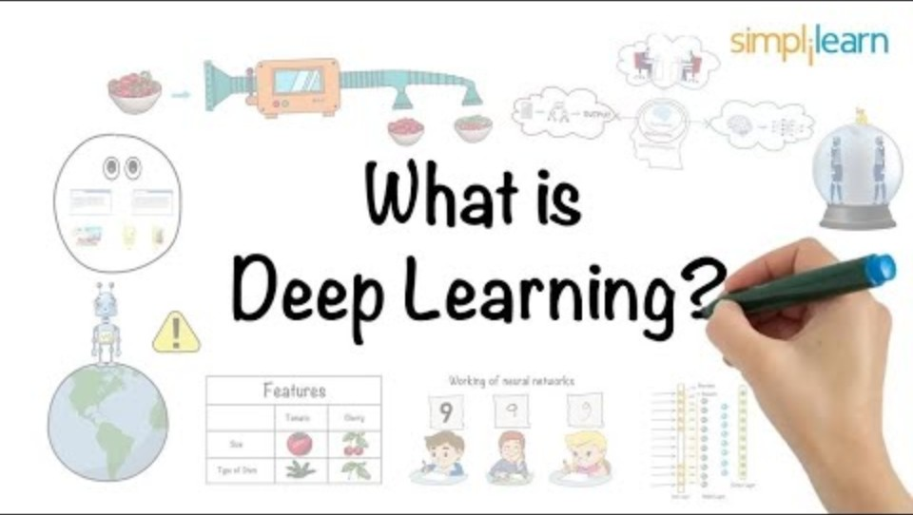
BREAK - What is Deep Learning? (5:51)
https://www.youtube.com/watch?v=6M5VXKLf4D4

Slide 25
Part 4: Deep Learning
When shallow networks aren't enough

Slide 26
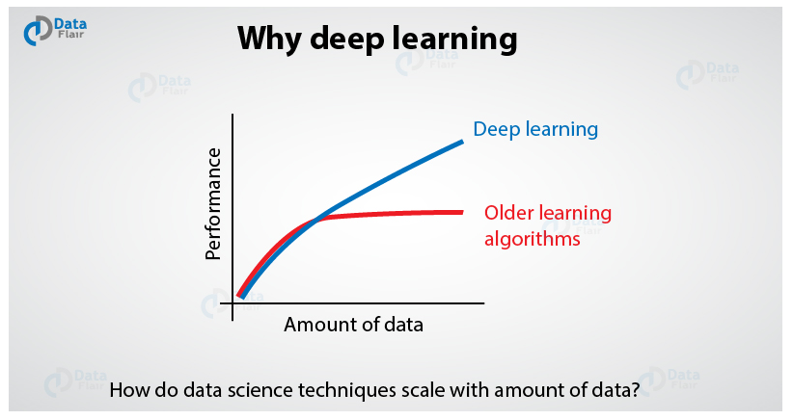
Why Go Deeper Than One Hidden Layer?
Shallow networks plateau in performance as data grows.
Deep networks keep improving as data grows.
Neural scaling laws (2020)
Performance improves predictably with more compute, more training data, and more parameters (bigger models).
This discovery launched the race to build ever-larger models → GPT, Claude, and beyond.

Slide 27
Shallow vs. Deep Networks
Shallow (1 hidden layer)
Deep (many hidden layers)
Can theoretically learn any function
Easier to train
May need exponentially many neurons
Performance plateaus with more data
Learns hierarchical representations
More parameter-efficient for representing complex functions
Keeps improving with more data
Harder to train (vanishing gradients)
Key insight: depth enables learning abstractions built on abstractions.

Slide 28
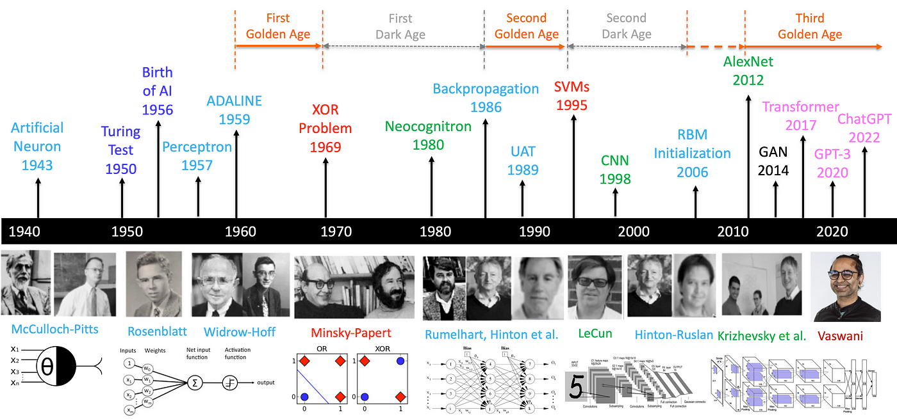
A Brief History of Deep Learning
From McCulloch–Pitts (1943) and the perceptron (1958) through backprop (1986), AlexNet (2012), the Transformer (2017), and ChatGPT reaching the mainstream (2022).

Slide 29
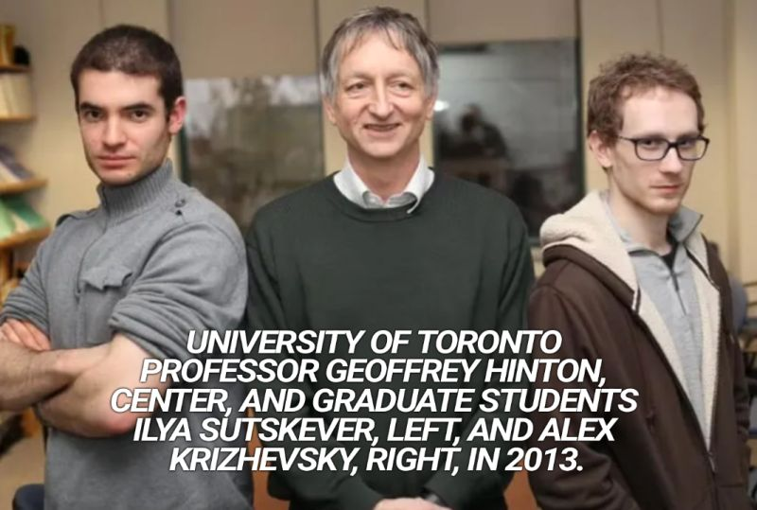
The 2012 Breakthrough: AlexNet
ImageNet error rate (lower is better):
2011 (pre-deep)
26%
2012 AlexNet
16%
2015 ResNet
3.6%
Human
5%
Three factors enabled the breakthrough:
Big Data (ImageNet) · GPU computing (NVIDIA) · algorithmic advances (ReLU, dropout).

Slide 30
Part 5: Specialized Architectures
Different data types need different network designs

Slide 31
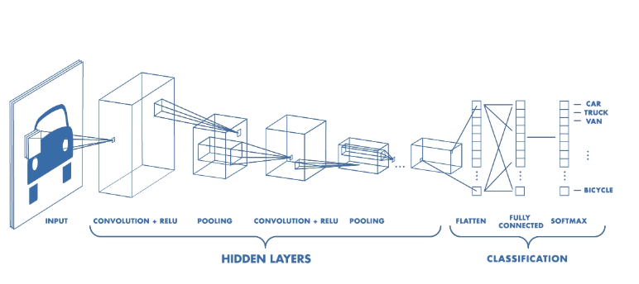
Convolutional Neural Networks (CNNs)
Instead of looking at every pixel independently, CNNs scan for patterns with small “filters” that slide across the image.
Layer 1
Layers 2–3
Deep layers
Detects edges and simple lines
Combines them into shapes & textures
Recognizes objects (faces, cars, cats)
Used in: face recognition, medical imaging, self-driving cars, photo filters.
https://towardsdatascience.com/convolutional-neural-networks-explained-9cc5188c4939

Slide 32
Recurrent Neural Networks (RNNs)
RNNs have “memory” — they remember what came before while processing the current input.
Predicting the next word: “The cat sat on the ___” — the RNN uses “cat / sat / on / the” to predict “mat.”
Limitation
Solution → Transformers
Struggles with very long sequences
Earlier context fades ('vanishing memory')
Look at all words at once
Coming up next…
https://hastie.su.domains/ISLR2/ISLRv2_website.pdf

Slide 33
Transformers: The Attention Mechanism
Google, 2017 — “Attention Is All You Need”
Core idea
When processing each word, look back at ALL other words and focus on the most relevant ones. “The animal didn’t cross the street because IT was too tired” → attention links “it” to “animal,” not “street.”
RNN (old)
Transformer (new)
Words processed one at a time
Slow; loses long-range context
All words at once (parallel)
Attention finds the connections
Powers GPT (ChatGPT), BERT (Google Search), Claude, DALL·E, and more — faster training and better context.

Slide 34
Large Language Models (LLMs)
Transformers scaled up to unprecedented sizes — the scale revolution:
GPT-1 (2018)
117M parameters
GPT-2 (2019)
1.5B parameters
GPT-3 (2020)
175B parameters
GPT-4 (2023)
~1T+ parameters
Bigger models + more data → emergent capabilities: reasoning, coding, creativity.

Slide 35
Part 6: Making Deep Learning Practical
Techniques that make it work in the real world

Slide 36
Transfer Learning & Fine-Tuning
Don’t train from scratch — build on what others already learned.
The problem
The solution
Training from scratch needs massive datasets
Expensive compute
Weeks of training
Start with a pre-trained model
Fine-tune on your data
Works with small datasets
Example
BERT learned language from Wikipedia (billions of words); fine-tune it for spam detection with just 1,000 labeled emails. This is why you can build powerful AI without Google-scale resources.

Slide 37
Multimodal & Generative AI
Modern models handle multiple input types — and create new content, not just classify it.
Multimodal — combines: text · images · audio · video
e.g., “Upload a photo of my fridge — what can I make for dinner?” → the model reads the image and answers in text.
Generative type | Examples | Produces
Text | ChatGPT, Claude | Conversations, code, essays
Image | DALL·E, Midjourney | Art from text prompts
Audio | Suno, ElevenLabs | Music, voice cloning
Video | Sora, Runway | Video from descriptions
These models learn the “distribution” of their training data, then sample new examples from it.

Slide 38
Part 7: Challenges & Limitations
Deep learning is powerful, but not perfect

Slide 39
The Black Box Problem
We often can’t explain WHY a neural network made a decision.
Input
(image)
Neural network
???
Output
“cat”
Why this matters — unanswered questions:
Medical diagnosis: “Why did the model recommend this treatment?”
Loan decision: “Why was my application denied?”
Self-driving: “Why did the car brake suddenly?”
Active research area: Explainable AI (XAI) aims to make models interpretable.

Slide 40
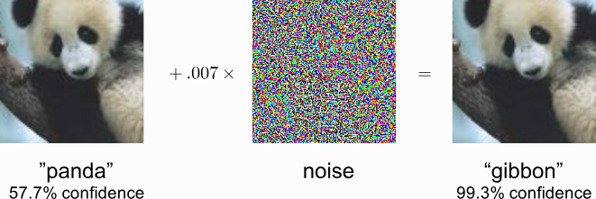
Adversarial Examples: Fooling Neural Networks
The famous panda attack: add noise invisible to humans, and the model’s answer flips completely.
“panda” (57.7%) + imperceptible noise = “gibbon” (99.3% confidence)
Security risk for AI systems (self-driving cars, facial recognition)
Shows networks don’t “understand” images the way humans do
https://share.google/images/xAQo7li22MjLgTxy6

Slide 41
Other Key Challenges
These are active research areas — the field is improving rapidly.
Challenge | What it means | Emerging remedy
Data hungry | Often needs millions of labeled examples | Few-shot learning
Compute expensive | Training large models costs millions | Efficient architectures
Bias & fairness | Models can amplify societal biases | Careful data curation
Hallucinations | LLMs state false information confidently | Retrieval augmentation

Slide 42
Key Takeaways
Networks learn by example They adjust weights to reduce prediction error — no hand-written rules.
Deep = layers of abstraction Many layers learn hierarchical representations, built on each other.
Right architecture for the data CNNs for images, RNNs/Transformers for sequences.
Powerful but imperfect Interpretability, robustness, and bias remain open challenges.

Slide 43
Let’s Discuss (5–10 min)
Neural networks can now match or beat humans at many narrow tasks, yet can’t explain their reasoning. For a decision in your field, is a more accurate “black box” worth less transparency — or not?
Adversarial examples show models don’t “see” like us. Where could that gap cause real harm — and what safeguard would you require before deploying such a system?
Alternate: the same architecture (the Transformer) now powers text, images, and audio. What does it mean that one idea generalized so widely?

Slide 44
Try It Yourself & Learn More
Hands-on (take-home)
Go deeper
TensorFlow Playground — playground.tensorflow.org: build a net, solve XOR, watch the boundary evolve
Google Quick, Draw! — quickdraw.withgoogle.com: a CNN guesses your sketch in real time
3Blue1Brown — “Neural Networks” series (visual, no math needed)
fast.ai — “Practical Deep Learning” (free, hands-on coding)

Slide 45
Demos
Sensors
Environment
Percepts
Agent
?

Slide 46
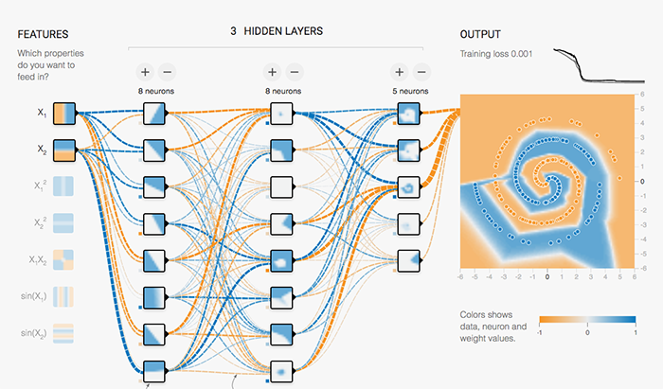
Hands-on: TensorFlow Playground
https://playground.tensorflow.org/
Try these experiments:
  Linearly separable data: Can a single neuron (no hidden layers) solve it?
  XOR pattern: Add hidden layers until it works. What's the minimum?
Spiral pattern: Experiment with:
  Number of hidden layers
  Neurons per layer
  Activation functions (ReLU vs. Sigmoid)
  Learning rate
Observe: How does the decision boundary evolve during training?

Slide 47
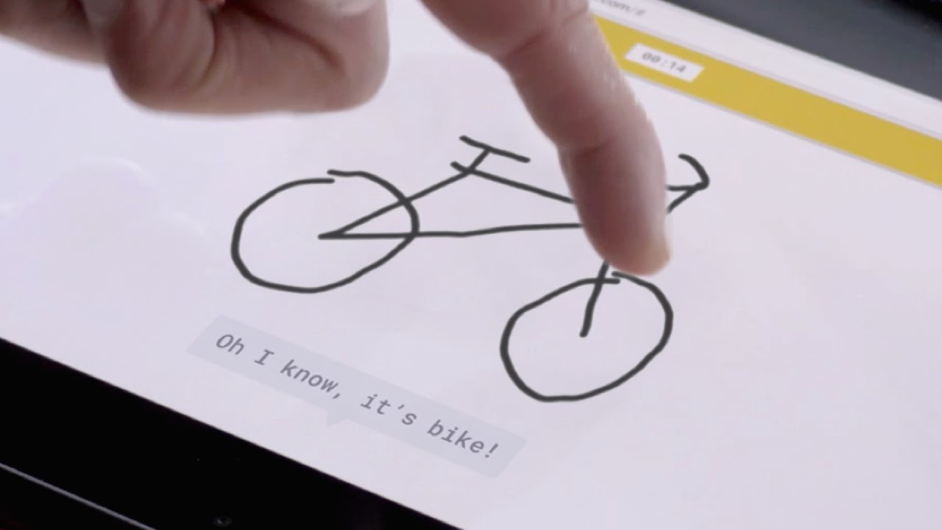
Hands-on: Google Quick, Draw!
https://quickdraw.withgoogle.com/
The experience:
  You're given an object to draw (e.g., "cat")
  You have 20 seconds to sketch it
  A neural network tries to recognize your drawing in real-time
While playing, notice:
  How quickly does it recognize your drawing?
  What features does it seem to rely on?
  When does it get confused?
Behind the scenes: CNN trained on millions of human sketches

